Slide 1
PREDICTING THE CARAVAN INSURANCE POLICY USER’S
TEAM – DATA NINJAS
Notes:
Hello Good Morning, Today, we're here to discuss the predictive modeling of caravan insurance policy users and its significance.

Slide 2
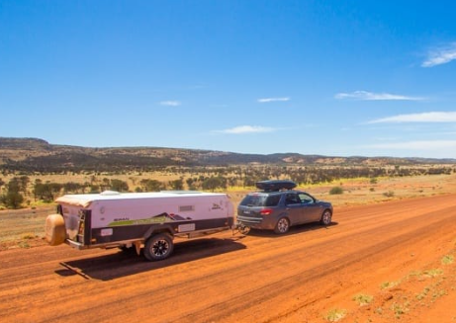
CARAVAN
Notes:
Caravans are mobile homes that are normally towed by cars. They are called trailers in North America.

Slide 3
TEAM MEMBERS:
PAVAN PABBA
REVANTH MANDADI
GAYATHRI KASTURI
SUNIL GANGUPAMU
LAVANYA PEDDIREDDI
HARI KRISHNA
Notes:
I’m Pavan, You know Peloton. Peleton is an exercise equipment company lost 1.5 billion dollars due to their poor marketing strategies or targeting the wrong customers and I’m here with a solution for those kind of problems with my team Revanth, Gayathri, Sunil, Lavanya and Hari.

Slide 4

AGENDA :
Business Context and Solution
​Advantages
​Dataset Exploration
Data Cleaning and Model Fitting
Comparison of Results
Conclusion
Future Scope
Notes:
In this presentation we are going to discuss the Business Context and Solution, Advantages for Business, Exploring the dataset, Process of data cleaning and model fitting, Models Comparison and results finally, Conclusion and the Future Scope.

Slide 5
Business Problems:
Insurance Companies are spending insane amount on customer acquisition in various ways/systems.
Targeting wrong customers repeatedly could damage company reputation.
We can resolve this by a predictive modelling, If the Company would know more precisely whom to target. This targeted approach aims to optimize our Customer Acquisition Cost (CAC) by allocating resources to prospects most likely to convert.
Notes:
Now let’s dive into the Business Problem:
Insurance Companies are spending huge amounts of money on customer acquisition in various ways. They are spending money on mailing systems and customer care support executives. Designing the mailing system and employing someone to call and ask the customers to take the policy.
However, we all know that majority of people will ignore this and show uninterested in this and they treat the mails as “SPAM”, “JUNK”. Every time we call and say Hello, We are calling from the insurance company or some other they say “NO” they won’t listen and may be they don’t have enough time to speak with random persons.
Targeting the wrong customers repeatedly also could damage the company reputation. We take Peloton example, Peloton lost 1.5 billion$ stock in just 48 hrs. Peloton released a holiday advertisement saying that they are going to gift one of their exercise bike and embarking on a fitness journey it is not the issue. The real problem arose when peloton followed up with targeted advertisements. They promoting their exercise equipment and services to individuals who had already purchased their products and had no interest in fitness. These repetitive ads not only irritated existing customers but also made the company appear out of touch with its audience. This incident damaged Peleton’s reputation and led to negative publicity.
Companies must carefully manage their advertising and marketing campaigns to ensure they are relevant to their target audience. Otherwise, they risk alienating their customer base and creating a negative perception of their brand, as seen in the Peloton example.
We have a solution for this. It can be solved by predictive modelling. This model can identify potential customers who would be interested in a Caravan Insurance Policy.

Slide 6
Advantages to Business:
Optimal Marketing and Sales Strategies
Customized Policy Recommendations
Companies will get more returns as they can predict their clients.
Competitive Advantage
Notes:
Moving on the Advantages,
Predictive models can Identify the potential customers who are more likely to buy the caravan insurance, allows insurance companies to target their marketing and sales strategies more effectively.
By analyzing customer data and preferences, predictive models can suggest policy options that are most suitable for individual customers, enhancing the personalization of insurance offerings.
Companies will get more returns as they can predict their customers.
Insurance companies that use predictive models effectively can gain a competitive edge by offering more accurate pricing and better-tailored policies, attracting more customers and retaining existing ones.

Slide 7
Data Exploration:
Data Set : Insurance Company Benchmark (COIL 2000)
Link to Data Set: https://archive.ics.uci.edu/dataset/125/insurance+company+benchmark+coil+2000 . Author: Peter Putten
This data consists about customers consists of 86 variables and includes product usage data and socio-demographic data derived from zip area codes. The training set contains over 5000 descriptions of customers, including the information of whether they have a caravan insurance policy. A test set contains 4000 customers of whom only the organizers know if they have a caravan insurance policy.
Notes:
The data was supplied by the Dutch data mining company Sentient Machine Research and is based on a real-world business problem.
Information about customers consists of 86 variables and includes product usage data and socio-demographic data derived from zip area codes.
The training set contains over 5000 descriptions of customers, including the information of whether they have a caravan insurance policy. A test set contains 4000 customers of whom only the organizers know if they have a caravan insurance policy.

Slide 8
Features and Targets :
Here in this data set we have three files.
TICDATA2000.txt: Dataset to train and validate prediction models and build a description (5822 customer records). Each record consists of 86 attributes, containing sociodemographic data (attribute 1-43) and product ownership (attributes 44-86). The sociodemographic data is derived from zip codes. All customers living in areas with the same zip code have the same sociodemographic attributes. Attribute 86, "CARAVAN: Number” of mobile home policies", is the target variable.
TICEVAL2000.txt: Dataset for predictions (4000 customer records). It has the same format as TICDATA2000.txt, only the target is missing. Participants are supposed to return the list of predicted targets only. All datasets are in tab delimited format.
Notes:
Here are the Features and Targets, As I said earlier there are 86 attributes including Target.

Slide 9
Data Preprocessing :
Identifying Missing Values
Imputing Values
Checking Column names
Addressing the Data Imbalance (SMOTE).
Feature Selection based on Correlation

Slide 10
Model Fitting :
Selecting the Model
Split the data into Trian and Test
Data Scaling
Fit the Model
Model prediction by Metrics Used
Model Scoring

Slide 11

Prediction Process:
Collect the Data
Clean the Data
Split the data
Train the data
Scaling the data
Fitting the models
Predicting “Yes” or “No” in Target Variable

Slide 12
Models Used for Prediction:
Decision Tree
Random Forest
XG Boost
Gradient Boost
SVC

Slide 13
Models Comparison :
Model | Recall | AUC
Decision Tree | 0.92 | 0.91
Random Forest | 0.955 | 0.988
XG Boost | 0.953 | 0.98
Gradient Boost | 0.94 | 0.96
SVM | 0.94 | 0.98

Slide 14
Models Comparison :
On Comparing all the models, We came to conclusion that Random Forest is the best model by using “Recall” metrics.
My primary goal is to maximize recall (identifying customers who will buy caravan insurance), then the Random Forest model with hyperparameters obtained from Grid Search seems to be the best choice, as it has the highest recall among all models. Additionally, the Random Forest model also has a high AUC (0.988), indicating good overall performance in terms of distinguishing between positive and negative cases.

Slide 15
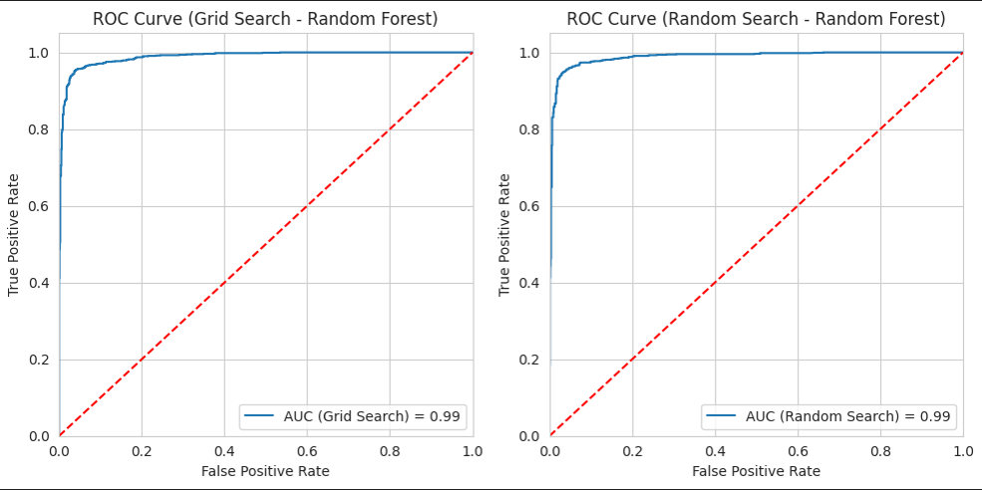
Random Forest ROC Curve :

Slide 16
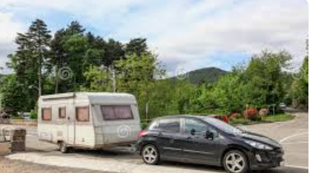
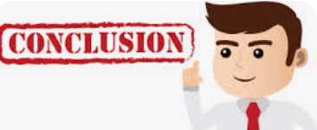
Conclusion ??

Slide 17
Conclusion :
Metrics Used
Why we Choose “Recall” as metric ?
A high recall means that the model is good at identifying most of the relevant instances of the class it's supposed to detect.
It suggests that the model has a low rate of false negatives, meaning it rarely misses positive cases.
We got Recall as 0.956 for our Random Forest Model.

Slide 18

Future Scope:
Tailor Insurance Policies to Individuals
Marketing Strategies can be improved
These kind of predictive models can be used in different types of Insurances as well.

Slide 19

Thank You…

Slide 20

Any Questions or Suggestions?

